Slide 1
Advanced Embedded System Design Project
Project Title: Automated RPM Balancer for Dual-Motor Systems Using FreeRTOS
Submitted By: Kunal Sharma (21uec080)
Garvit Goyal (21dec004)
Supervised By: Dr. Deepak Nair
(Assistant Professor ECE, LNMIIT)

Slide 2
Components Used
Optical Encoder
Arduino Uno
DC Motor
L298N Motor Driver
Steel Chassis
Breadboard
Jumper Wires….

Slide 3
Project Description
This project focuses on developing a robust control system for an autonomous vehicle using FreeRTOS, designed to ensure that both wheels of the car rotate at the same speed.
The primary goal is to achieve synchronized wheel motion, enhancing vehicle stability and performance, especially during turns or uneven terrain navigation.
The Adaptive Wheel Synchronization System aims to enhance the performance of autonomous vehicles by ensuring synchronized wheel motion, thereby improving stability and control. By leveraging FreeRTOS, the project emphasizes real-time responsiveness and efficient multitasking, providing a solid foundation for future advancements in autonomous vehicle technology.

Slide 4
Problems Faced
No two motors are identical so when deployed in the system it can cause synchronization issues.
For storing the state in static variables may cause variable corruption.
Queues Synchronization
Memory Optimization
Switching Speed of optical encoder and it’s effect with motor speed

Slide 5
Solution
Use of optical encoders to keep the track of wheel rotation.
Usage of queues instead of static variables.
Usage of built-in API for getting unused stack space allocated.
Usage of Task-Yielding as to increase the responsiveness of the system.

Slide 6
Block Diagram
IR Sensor
Power Supply
Power Supply
Microcontroller
-
PWM1
L298N
PWM2
Motor1
Motor2
Optical Encoder1
Optical Encoder2

Slide 7
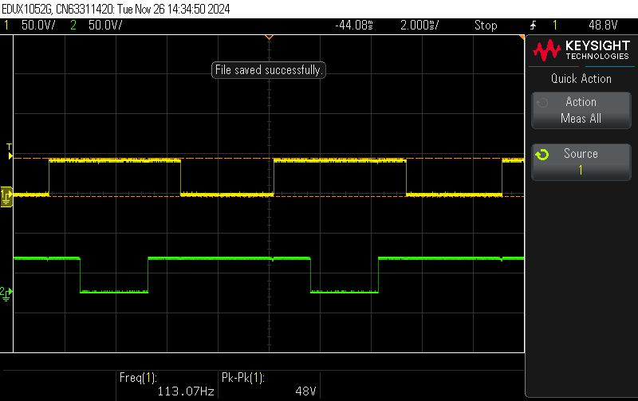
Observations
Optical encoders are utilized to detect the motion of a wheel by employing an optical disc positioned between the infrared (IR) emitter and receiver of the encoder.
As the wheel rotates, the encoder detects motion by monitoring the interruptions in the IR beam caused by the disc's patterned design.
This interruption generates a series of pulses that correspond to the rotational movement, allowing precise measurement of the wheel's motion.

Slide 8
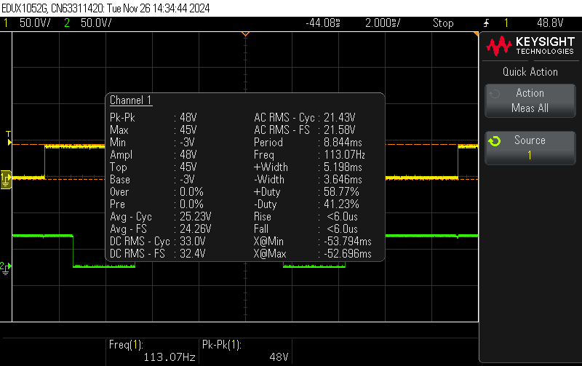
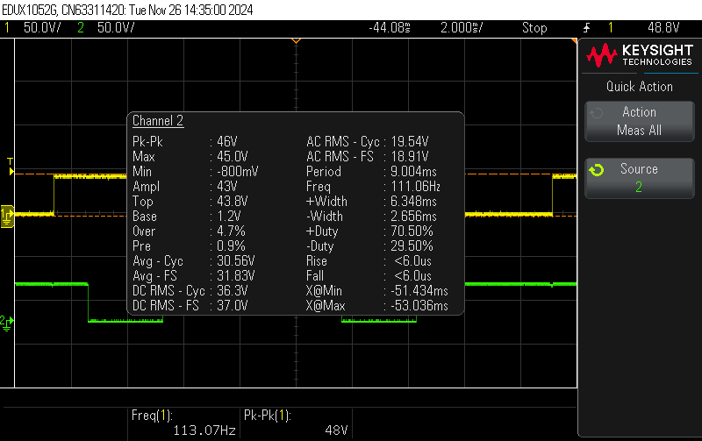
Contd.
Characteristics of Optical Encoder (Left)
Characteristics of Optical Encoder (Right)

Slide 9
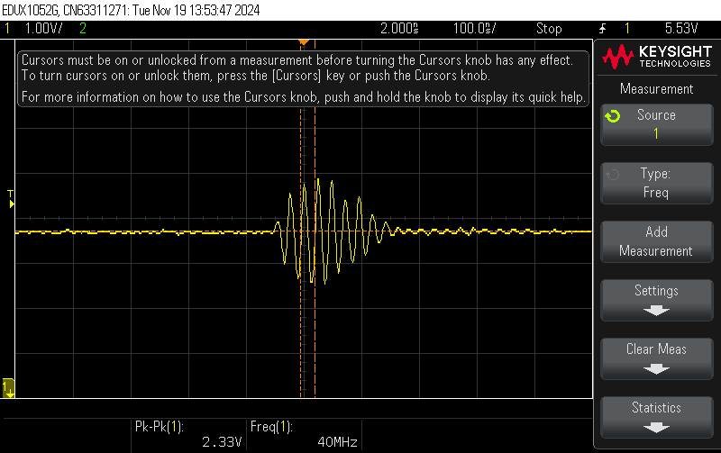
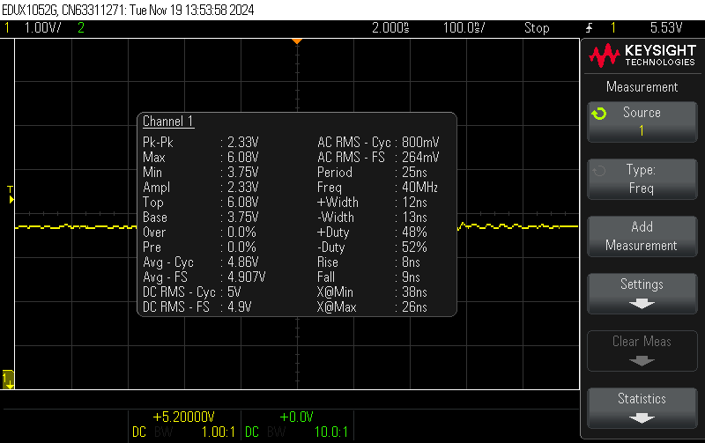
Output Ripple of Power Supply
Output Ripple Waveform
Output Ripple Waveform Charcateristics

Slide 10
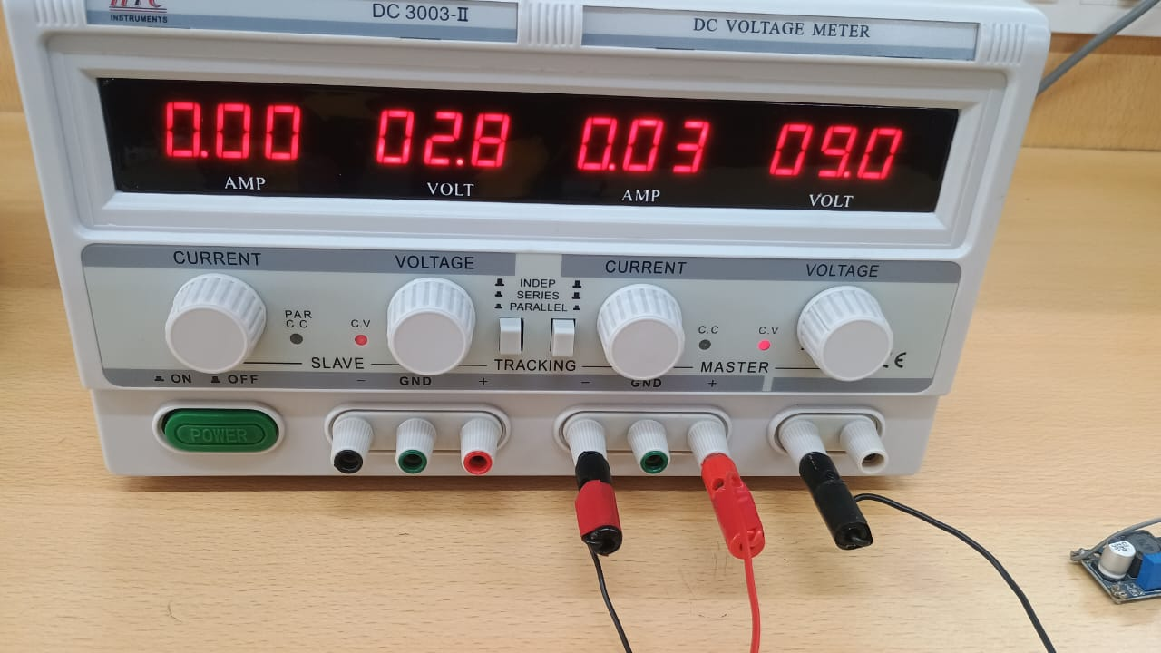
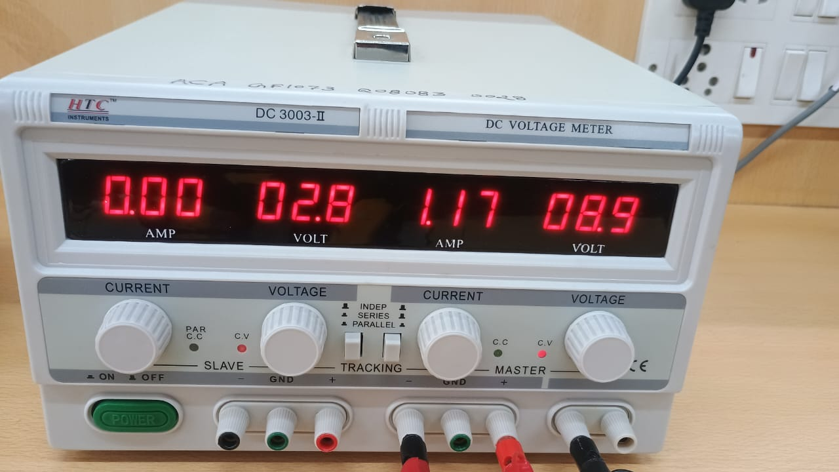
Current Consumption
Current Consumption in IDLE State(0.27W)
Current Consumption in Running State(10.53W)

Slide 11
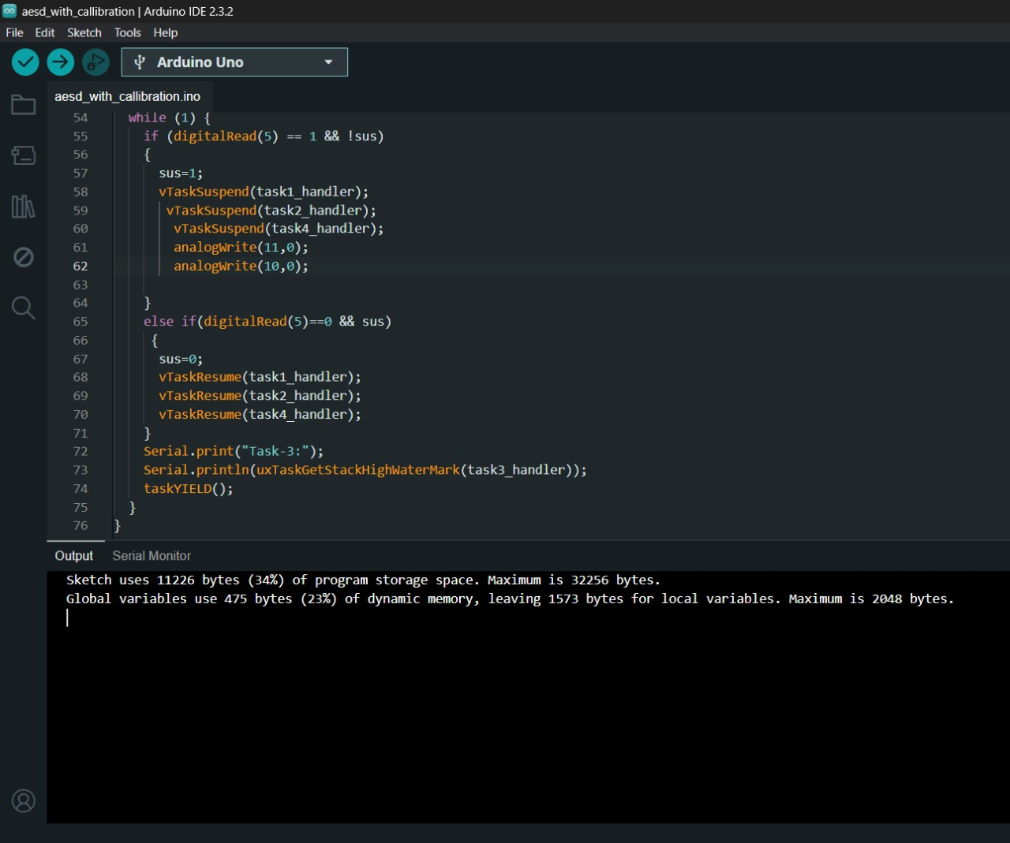
Memory Consumption of Micro-Controller
Program Storage Space (Flash Memory)
Total Flash Memory: 32,256 bytes.
Used by Sketch: 11,222 bytes (34% utilized).
Available for Program Code: 21,034 bytes (66% free).
Dynamic Memory (SRAM)
Total SRAM: 2,048 bytes.
Used by Global Variables: 475 bytes (23% utilized).
Available for Local Variables and Stack: 1,573 bytes (77% free).

Slide 12
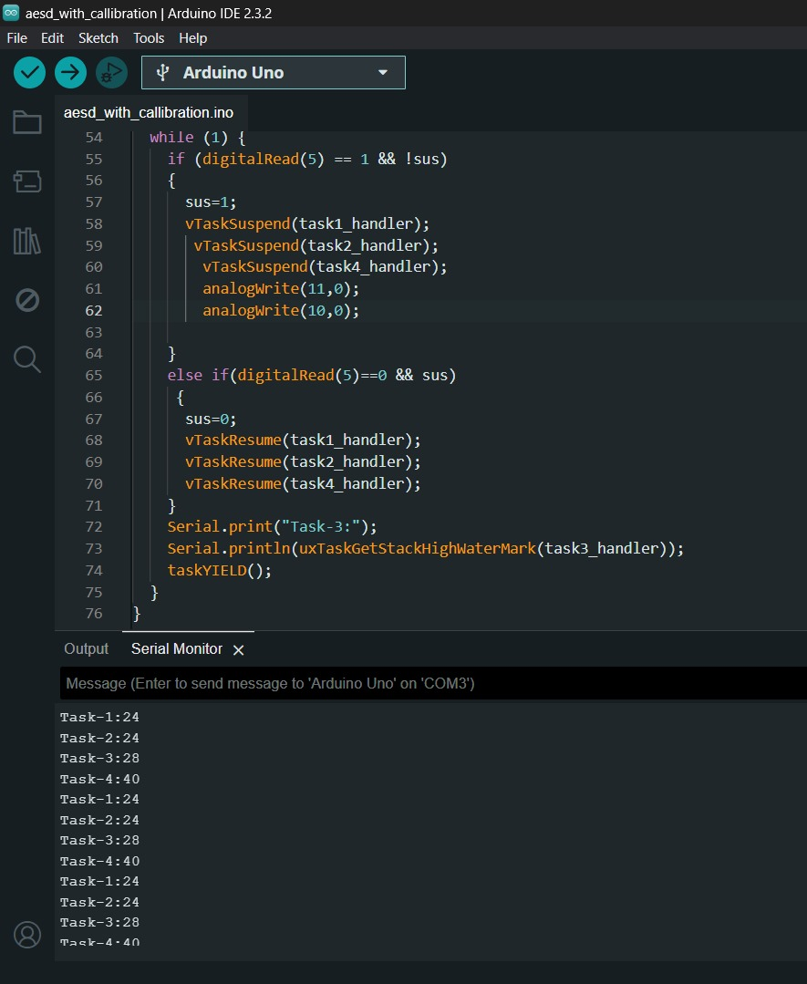
Optimizing Stack Size of Tasks
This API uxTaskGetStackHighWaterMark()returns the minimum amount of stack space that remained unused (high water mark) at any point since the task started running.
It helps identify how much of the allocated stack was actually used.
Use the high water mark value to calculate the actual required stack size: Required Stack Size=Allocated Stack Size−High Water Mark
High Water Mark: Task-1(24), Task-2(24), Task-3(28), Task-4(40)
Benefits:
Reduced Memory Footprint: More memory is available for other tasks or dynamic allocations.
System Stability: Tasks with optimized stack sizes reduce the risk of stack overflow.
Improved Debugging: Identifying tasks with insufficient stack can prevent hard-to-diagnose crashes.

Slide 13
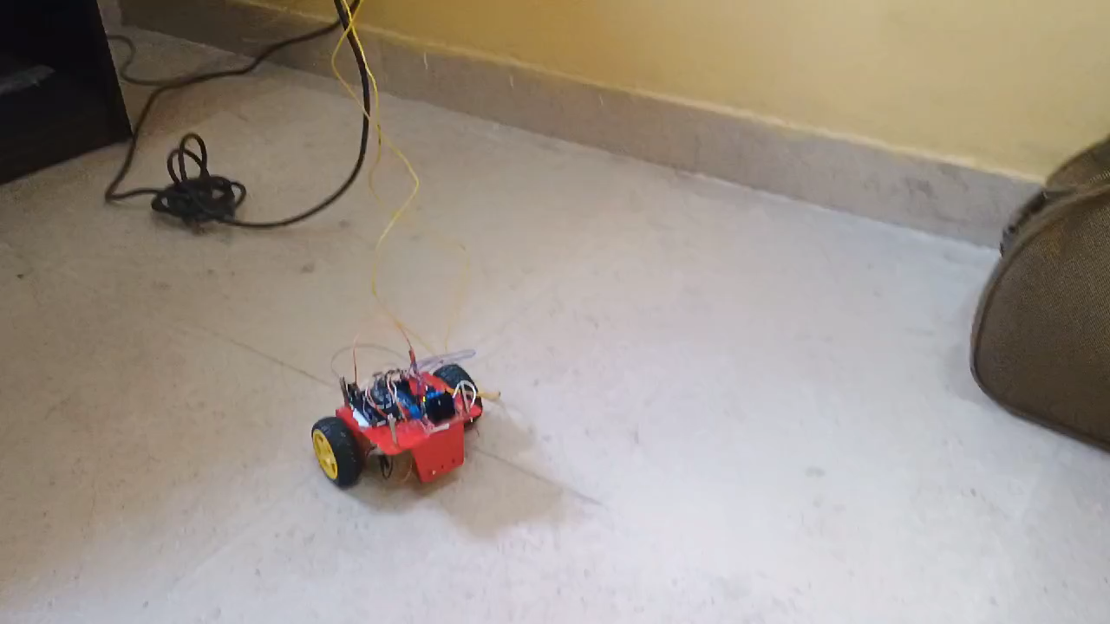
System Without FreeRtos

Slide 14
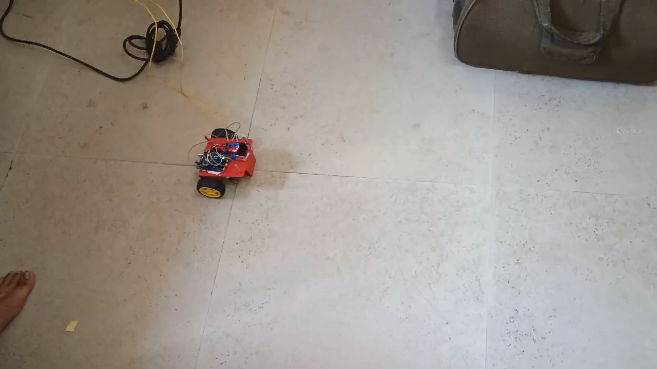
System With FreeRtos

Slide 15
Conclusion
FreeRtos provides way of reading from the sensors in time critical manner.
Super Loop Doesn’t provide the functionality of priority that is used in our application in the IR sensor reading task i.e. to stop motor immediately as soon as any obstacle comes closer than the threshold distance.
Task Yield is possible as it provides the facility of task switching as soon as it finishes it’s job and does not wait for the complete tick size which improves the responsiveness of the system.
FreeRtos provides us the facility of resume and suspend tasks as per our application all the tasks must be suspended as soon as the IR sensor is detecting an obstacle in the sensing range.
Able to balance speed of motors if the speed is ~400 rpm.

Slide 16
References
https://www.freertos.org/
https://www.freertos.org/Documentation/00-Overview
Advanced Embedded Systems Design Course By Dr. Deepak Nair
https://cdn-shop.adafruit.com/product-files/3986/ee-sx47_67_ds_e_13_2_csm483

Slide 17
Thank You
&
Queries Please….

